Slide 1
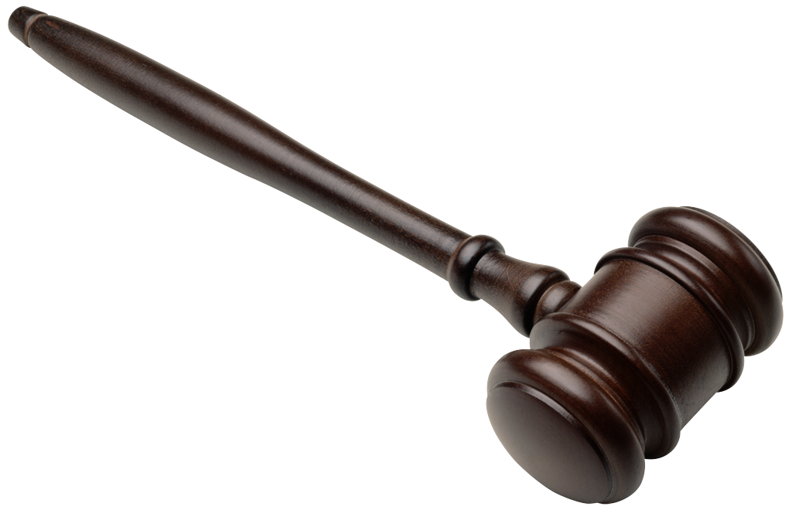
Trial Procedures
Business Law
Chapter 6

Slide 2
Trial Procedures
Civil Cases are brought by individuals
Injured party begins the lawsuit by filing a complaint with the court
Criminal Cases are brought by the government
Misdemeanors - the action begins when a police officer issues a summons for the suspect to appear in court
Felonies - action begins with a hearing before a judge to see if there is probable cause to refer the case to the prosecuting attorney

Slide 3
Trial Procedures
Civil Trial Procedure
Complaint is filed
Complaint - a legal document containing a short and plain statement of the plaintiff’s claim against the defendant
Court notifies the defendant. Must respond in a given time period or lose the case.
Answer - a formal written document that admits or denies each allegation of the complaint and states any defenses that the defendant plans to use.

Slide 4
Trial Procedures
Pleadings - papers filed with the court by the plaintiff and the defendant. They establish the issues of allegations and the defendants answers.
Facts of the case are made known to all parties
Methods of Discovery - methods used to bring facts out before the trial
Ex.: depositions, interrogatories, requests for documents and other evidence, physical and mental examinations, and requests for admission

Slide 5
Trial Procedures
Pretrial Hearing - informal hearing before the judge to simplify the issues
Steps in a Jury Trial
Selecting the Jury - attorneys think about the juror’s background, education, experience, relationships, attitudes, and employment
Opening Statements - plaintiff’s attorney makes an opening statement first.
Introduction of Evidence - Prosecuting attorney presents to the court and jury all of the state’s evidence
Ex.: documentary evidence (papers), affidavits, (sworn statements), real evidence (actual objects), and witnesses

Slide 6
Trial Procedures
Subpoenaed - requested by a court order to appear in court.
Defendant’s attorney has the opportunity to cross-examine (question) the plaintiff’s witnesses
Defendant’s attorney presents evidence favorable to the defendant.
Plaintiff’s attorney can cross-examine the defendant’s witnesses
Notes:
Subpoenaed - requested by a court order to appear in court.
Defendant’s attorney has the opportunity to cross-examine (question) the plaintiff’s witnesses
Defendant’s attorney presents evidence favorable to the defendant.
Plaintiff’s attorney can cross-examine the defendant’s witnesses

Slide 7
Trial Procedures
Closing Arguments - each attorney summarizes the evidence (plaintiff first) and makes suggestions for outcome
Instructions to the Jury - judge explains the law
Verdict and Judgment - jury room for deliberation/ reach verdict - decision of the jury
The court issues a judgment - the court’s decision or determination in a case
Execution of Judgment - winning and losing parties ex.: plaintiff may receive payment or defendant may be allowed to keep property

Slide 8
Trial Procedures
Criminal Trial Procedure
Arrest the Defendant
Arrest Warrant - an order issued by a court saying that a person is charged with a crime and is to be arrested
Rights of the Defendant - read the Miranda warnings - have the right to know: the crimes which they are charged, names of the police officers, to make a phone call, to remain silent, and to an attorney

Slide 9
Trial Procedures
Bail - money or other property left with the court to assure the court that the person will return to stand trial
Also have the right to a fair trial and to be presumed innocent until proven guilty.
Search and Seizure - an officer can search a person, motor vehicle, house or other building if permission is given or the officer has a search warrant.

Slide 10
Trial Procedures
Search Warrant - a court order allowing an officer to conduct the search
Persons who have been arrested may be searched without a warrant - also the vehicle or building
School officials can search students without a search warrant

Slide 11
Trial Procedures
The Arraignment - a procedure in which the accused is brought before the court, read the indictment or information, and asked to plead guilty or not guilty
An Information - a set of formal charges drawn up by the prosecuting attorney
Grand Jury - a jury of inquiry. A group of citizens called together by a court official to determine whether there is enough evidence to justify accusing certain persons of certain crimes.

Slide 12
Trial Procedures
Petit Jury - decides on the guilt or innocence of the person tried
Indictment - a written accusation issued by the grand jury charging the individual with a certain crime
Trial - same as civil court except
To convict a defendant in a criminal case, the jury must agree unanimously that the defendant is guilty beyond a reasonable doubt

Slide 13
Trial Procedures
Disposition of Juvenile Cases
Detention Hearing - to find out whether there are
Good reasons for keeping the accused in custody and whether or not there are special circumstances affecting the case
Adjudicatory Hearing - actual hearing of the case by the court (informal)
Sometimes the case is decided here

Slide 14
Trial Procedures
Dispositional Hearing - to decide how to dispose of the case
3 choices:
1. probation and return home
2. placed in an agency or foster home
3. commit the offender to a training school or reformatory

